Slide 1
Predicting smokers and drinkers using body signal data
Dr. Chaojie Wang
Department of Data Science,
University of Maryland, Baltimore County
Presented by:
Mani Teja Gunda
RQ47971

Slide 2
Introduction
This project aims to predict the smoking and drinking habits of an individual using the body health metrics
The predictive models will be built upon the data provided by National Health Insurance Services of Korea
The data contains health indicators such as height, weight, cholesterol levels, blood pressure readings and liver enzyme readings
Gain insights into the relationships between lifestyle choices (smoking/drinking) and health outcomes
We Identify patterns and correlations to enhance understanding of health implications associated with smoking and drinking

Slide 3
Real-World Applications
Health Risk Assessment - These tools have the potential to predict the likelihood of specific health complications based on an individual's habits and body signal measurements
Public Health Campaigns - Governments and health organizations can leverage the insights gained from this project to design targeted and personalized health interventions
Insurance Premium Calculation - Insurance companies can use the predictive model to adjust health insurance premiums based on the risk associated with smoking and drinking habits
Health Tracking Wearables - By integrating models trained on the dataset, wearable devices, such as smartwatches, can provide users with real-time feedback on the potential health impacts of their habits

Slide 4
Project Overview
Data Cleaning - Removed the duplicate and treated the null values
Data Pre-processing - Transformed the columns and their datatypes as per requirement
EDA and Research Questions - Exploratory Data Analysis for understanding the importance and correlation between columns and answering the research questions
Modelling - Training and testing the classification models separately for smoking and drinking and determining the best respective model
Web App - A web app for the user to input the data and get the predicted result

Slide 5
Research Questions

Slide 6
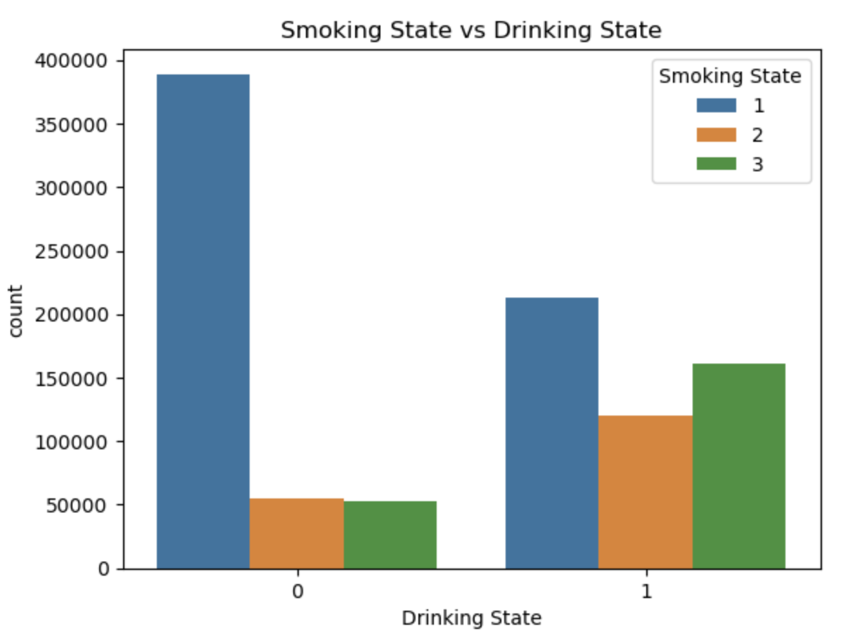
Do all drinkers smoke or Do all smokers drink?
Majority of the non-drinkers are non-smokers
While majority of drinkers are non-smokers, the gap between each of the smoking state is less
The number of drinkers who smoke are approximately three times the number of non-drinkers who smoke
- Doesn’t Drink
- Drinks
1 - never smoked
2 - used to smoke
3 - still smoking

Slide 7
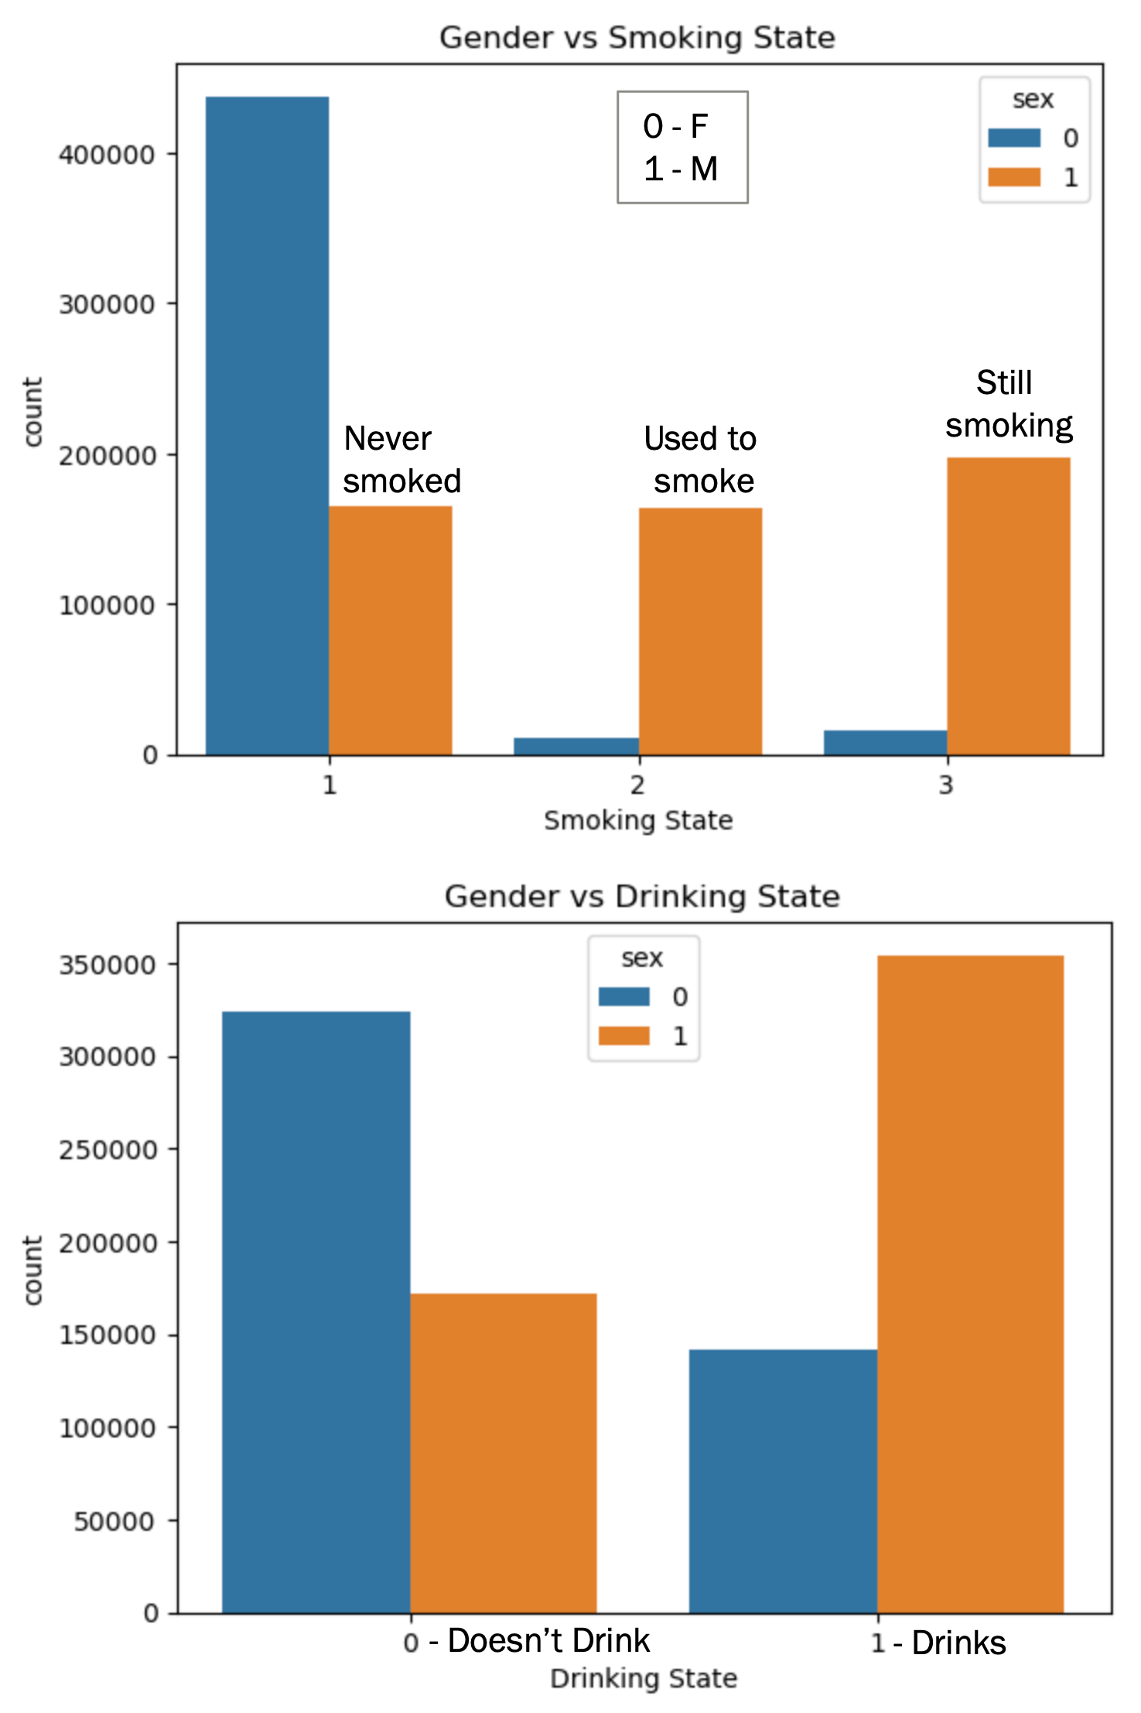
Is it true that most of the drinkers/smokers are men?
Majority of the non-smokers are female
Male population dominates in both the states of still smoking and quit smoking
Approximately 70% of the drinkers are male
Non-drinking female is almost twice the number of non-drinking male

Slide 8
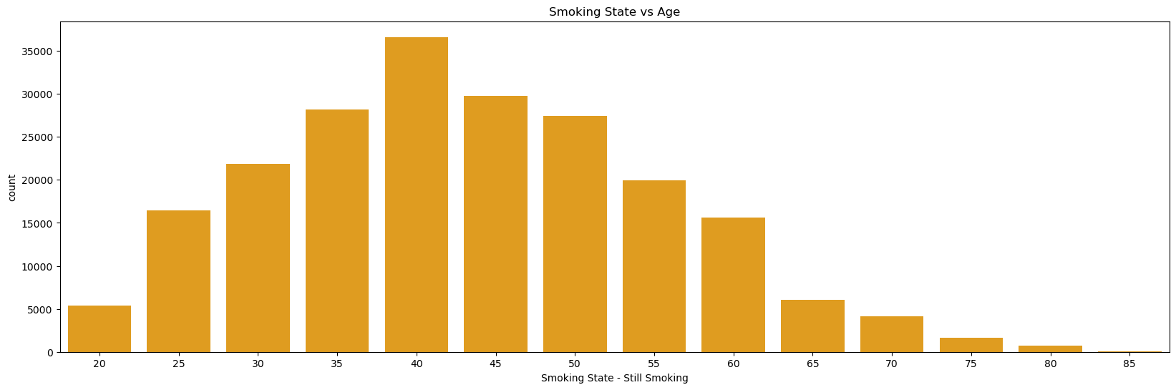
What age groups do most of the smokers belong to?
Most of the smokers are between 35 and 50 years

Slide 9
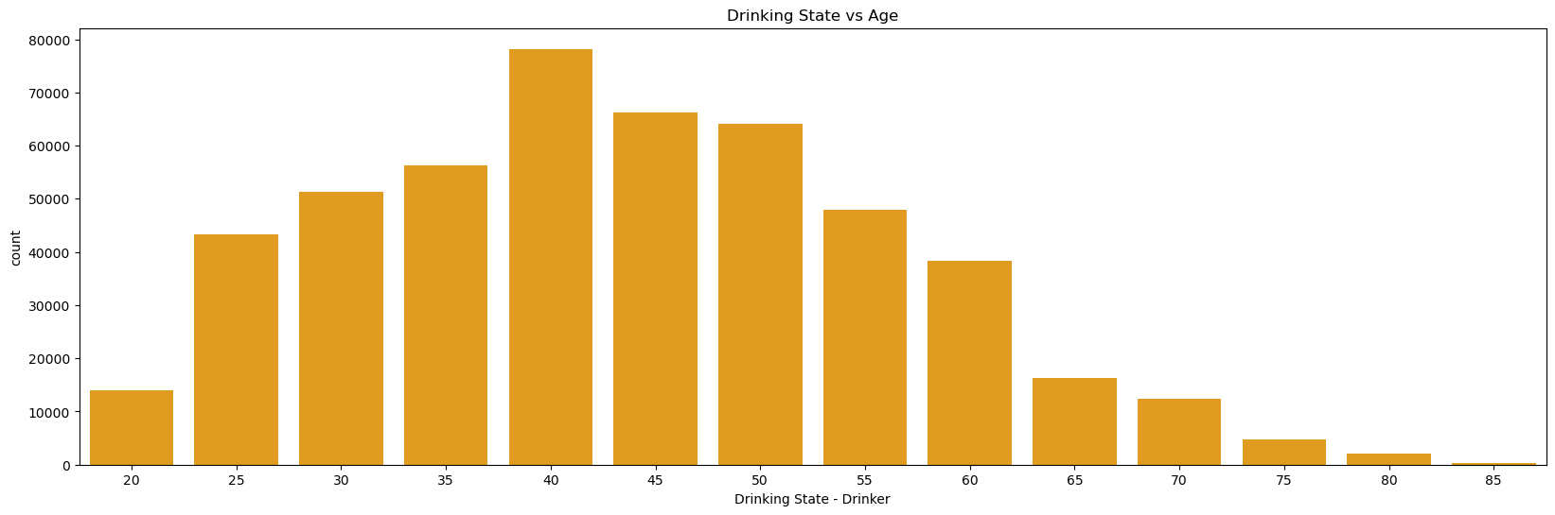
What age groups do most of the drinkers belong to?
Most of the smokers are between 30 and 50 years

Slide 10
What are the features that correlate with smoking and/or drinking habits?
We used Recursive Feature Elimination (RFE) module to determine the features that corelate with smoking and drinking respectively
Smoking | age | sex | HDL_chole | hear_left | hear_right | serum_creatinine | hemoglobin | waistline | SBP | weight | height
Drinking | age | sex | HDL_chole | hear_left | hear_right | serum_creatinine | hemoglobin | SGOT_ALT | DBP | gamma_GTP | sight_right

Slide 11
Model Training

Slide 12
Model Training
We trained 5 classification models for smoking and drinking separately.
Selected and finalized models based on accuracy scores
The 5 models are:
1. KNN
2. Logistic Regression
3. Decision Tree
4. Random Forest
5. Gradient Boosting

Slide 13
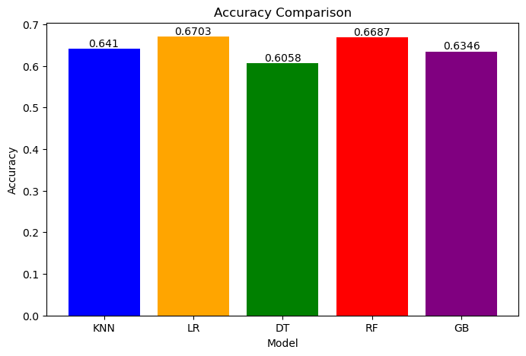
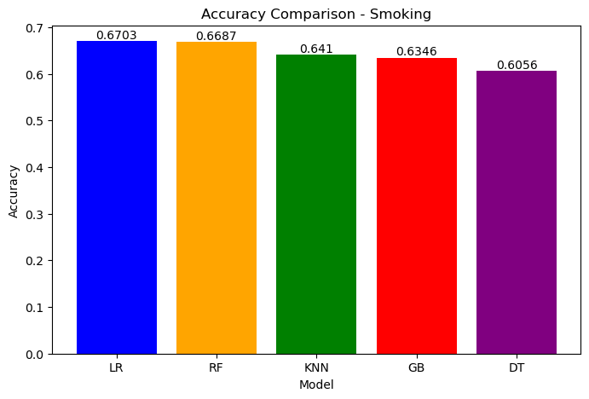
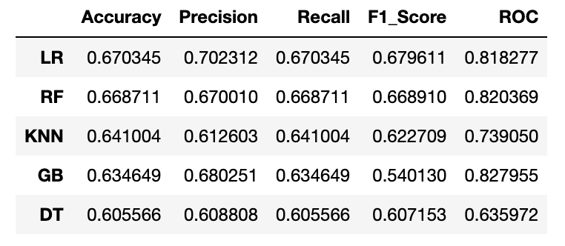
Model Comparison - Smoking

Slide 14
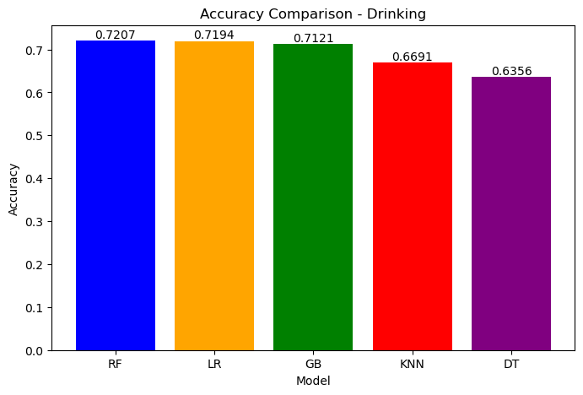
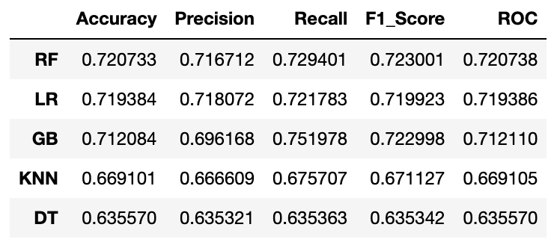
Model Comparison - Drinking

Slide 15
Model Results
For smoking, Logistic Regression produced results with comparatively highest accuracy (67%) and precision (70%)
For drinking, Random Forest produced results with comparatively highest accuracy (72%) and precision (71.6%)

Slide 16
THANK YOU

